Slide 1
Session 4
Module 7: Introducing stored procedures
Module 8: More about stored procedures
Notes:
ACCP2005/ Developing Enterprise Applications 2.0/ Session 1/ of 23

Slide 2
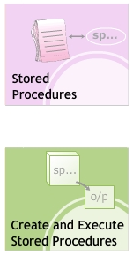
Module 7: Introducing stored procedures
Objectives
Notes:
ACCP2005/ Developing Enterprise Applications 2.0/ Session 1/ of 23

Slide 3
Stored Procedures
A stored procedure is a group of Transact-SQL statements that act as a single block of code that performs a specific task. This block of code is identified by an assigned name and is stored in the database in a compiled form.
Stored procedures are useful for performing repetitive tasks. This eliminates the need for repetitively typing out multiple Transact-SQL statements and then repetitively compiling them.
Stored procedures support user-declared variables, conditional execution and other programming features. Also, parameters can be passed between the stored procedure and the calling program.

Slide 4
Advantages – 1
Database developers or administrators write stored procedures to perform a variety of tasks related to database access and management.
Using stored procedures offer numerous advantages over using Transact-SQL statements. These are:
  Improved Security
  Precompiled Execution
  Reduced Client/Server Traffic
  Reuse of Code

Slide 5
Advantages – 2
Improved Security: by associating database privileges with stored procedures. Users can be given permission to execute a stored procedure even if the user does not have permission to access the tables or views.
Precompiled Execution: stored procedures are compiled during the first execution. For every subsequent execution, SQL Server reuses this precompiled version. This reduces the time and resources required for compilation.

Slide 6
Advantages – 3
Reduced Client/Server Traffic: stored procedures help in reducing network traffic.
Reuse of Code: stored procedures can be used multiple times. This eliminates the need to repetitively type out hundreds of Transact-SQL statements every time a similar task is to be performed.

Slide 7
System Stored Procedures
System stored procedures are used in database administrative and informational activities. These procedures provide easy access to the metadata information about database objects such as system tables, user-defined tables, views, and indexes.
System stored procedures logically appear in the sys schema of system and user-defined databases. When referencing a system stored procedure, the sys schema identifier is used. The system stored procedures are stored physically in the Resource database and have the ‘sp_’ prefix.

Slide 8
Extended Stored Procedures
The extended stored procedures are not residents of SQL Server. They are procedures that are implemented as dynamic-link libraries (DLL) executed outside the SQL Server environment.
Extended stored procedures use the ‘xp_’ prefix. Tasks that are complicated or cannot be executed using Transact-SQL statements are performed using extended stored procedures.

Slide 9
Temporary Stored Procedures
Stored procedures created for temporary use within a session are called temporary stored procedures. These procedures are stored in the tempdb database.
The tempdb system database is a global resource available to all users connected to an instance of SQL Server. It holds all temporary tables and temporary stored procedures.

Slide 10
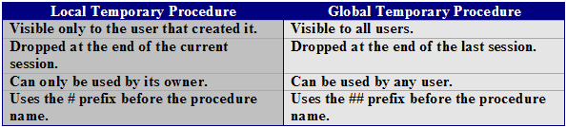
Types of
Temporary Stored Procedures
SQL Server 2005 supports two types of temporary stored procedures namely, local and global. The differences are:

Slide 11
Remote Stored Procedures
Stored procedures that run on remote SQL Server are known as remote stored procedures. Remote stored procedures can be used only when the remote server allows remote access.
When a remote stored procedure is executed from a local instance of SQL Server to a client computer, a statement abort error might be encountered. When such an error occurs, the statement that caused the error is terminated but the remote procedure continues to be executed.

Slide 12
Local Stored Procedures
Local stored procedures are created in individual user databases. A local stored procedure cannot be accessed by any user other than the one who has created it.
If the local procedure is a temporary procedure, it is dropped at the end of the session.

Slide 13
Custom Stored Procedures – 1
In SQL Server 2005, users are allowed to create customized stored procedures for performance of various tasks.
Syntax:
CREATE {PROC|PROCEDURE} procedure_name
[{@parameter data_type}] AS <sql_statement>
where:
  @parameter: specifies the input/output parameters in the procedure.
  data_type: specifies the data types of parameters.
  sql_statement: specifies one or more Transact-SQL statements to be included in the procedure.

Slide 14
Custom Stored Procedures – 2
Example:
CREATE PROCEDURE Show_Customers
AS
SELECT * FROM Customer_Details
To execute the stored procedure
EXECUTE Show_Customers
Custom stored procedures can be set to override the default system procedures.

Slide 15
Deferred Name Resolution
Statements in a stored procedure are checked for errors during the creation of the stored procedure. If an error is found, an error message is returned and the procedure is not created. If there are no errors, the procedure is created and the text of the procedure is stored in the sys.sql_modules catalog view.
At first instance of the stored procedure execution, the query processor reads the statements in the stored procedure from the sys.sql_modules catalog view. The processor then checks for the name of all objects used by the procedure. This check is known as deferred name resolution. If a referenced object is missing, the execution stops.

Slide 16
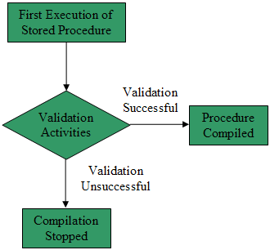
Deferred Name Resolution Process
Validation activities other than checking for referenced objects are also carried out in the deferred name resolution stage. For example, variables are checked for compatibility with the column data types. If an error is found in the resolution stage, SQL Server returns an error.
If the resolution stage of the execution process is successfully completed, the procedure is compiled. For every subsequent call to the procedure, this compiled version is used.

Slide 17
Transact-SQL
Stored Procedures – 1
A stored procedure can be created either for permanent use or for temporary use.
A stored procedure is created using the CREATE PROCEDURE statement.

Slide 18
Transact-SQL
Stored Procedures – 2
Syntax:
CREATE {PROC|PROCEDURE} procedure_name [{@parameter data_type} [=DEFAULT] [OUTPUT] ] [WITH ENCRYPTION]
AS <sql_statement>
where
  DEFAULT: specifies a default value for the parameter.
  OUTPUT: specifies that the parameter is an output parameter.

Slide 19
Transact-SQL
Stored Procedures – 3
Example:
CREATE PROCEDURE Display_Customers
AS
SELECT CustID, AccNo, AccName, City, State, Country FROM Customer_Details
To execute:
  EXECUTE Display_Customers

Slide 20
Using “OUTPUT” Clause
The OUTPUT clause returns information from each row on which the INSERT, UPDATE and DELETE statements have been executed. This clause is useful to retrieve the value of an identity or computed column after an INSERT or UPDATE operation.
Example:
CREATE PROCEDURE Display_Customers
@max_sal int OUTPUT
AS SELECT @max_sal = MAX(Salary) FROM Employee_Details
DECLARE @max_sal int;
EXECUTE Display_Customers @max_sal OUTPUT;
PRINT @max_sal;

Slide 21
Guidelines
When a local temporary table is created inside a stored procedure, the table disappears when the procedure is exited.
Stored procedures can reference tables, views, user-defined functions and other stored procedures.
When a stored procedure calls another stored procedure, the called procedure can access all objects created by the calling procedure.
Changes made by a remote stored procedure on a remote instance of Microsoft SQL Server 2005 cannot be rolled back.
A stored procedure can have a maximum of 2100 parameters.
The number of local variables in a stored procedure depends upon available memory.

Slide 22
Extended Stored Procedures
These stored procedures are contained in the dbo schema of the master database.
Extended stored procedures can be executed under the security limitations specified by the SQL Server.
Extended stored procedures execute in the process space of the SQL Server.
When an extended stored procedure is executed, the extended stored procedure’s DLL remains in the address space of the server unless it is unloaded by the administrator.

Slide 23
Module 7 - Summary
A stored procedure is a group of Transact-SQL statements executed as a single block of code.
SQL Server 2005 provides various system stored procedures that assist in database administrative activities.
User can create custom stored procedures for performing various tasks.
Deferred name resolution is the stage where the processor checks for names of the objects referenced by the procedure. This check is done during the execution of the procedure.
When a procedure is executed, parameters can be passed between the calling program and the stored procedure.

Slide 24
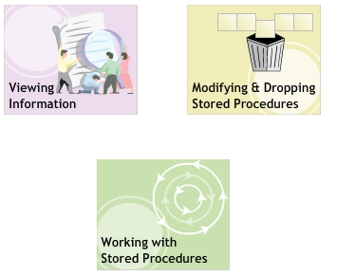
Module 8: More About Stored procedures
Objectives

Slide 25
Viewing Definitions
A stored procedure is defined using a set of Transact-SQL statements. This definition consists of two parts:
  Name, input and output parameters.
  Body
You can view the definition of a stored procedure using one of the following:
  sp_helptext system stored procedure.
  sys.sql_modules system view
  OBJECT_DEFINITION function

Slide 26
Viewing Definitions
Using “OBJECT_DEFINITION”
Syntax:
  OBJECT_DEFINITION ‘<object_id>’
  where,
  object_id: specifies the ID of the stored procedure.
Example:
  SELECT OBJECT_DEFINITION (OBJECT_ID (‘Display_Customers’) ) AS Definition
where,
  OBJECT_ID: is the system function that returns ID of the specified object.

Slide 27
Viewing Definitions
Using “sys.sql_modules”
Example:
  SELECT definition FROM sys.sql_modules WHERE object_id = OBJECT_ID (‘Display_Customers’)
where,
  definition: is the column in the sys.sql_modules system view that display the definition of the specified object.

Slide 28
Viewing Dependencies
In SQL Server 2005, the dependencies of a stored procedure can be viewed using the sp_depends system stored procedure.
Syntax:
  sp_depends ‘<procedure_name>’
Example:
  sp_depends ‘Display_Customers’

Slide 29
Modifying and
Dropping Stored Procedures
A stored procedure can be modified to change the procedure name as well as the procedure definition. You can change the procedure statements or parameters by either re-creating the stored procedure or by altering the existing procedure.
To modify or rename a procedure, you must either own the procedure or have the required permissions to carry out the modifications.
The database owner can modify or rename all procedures.

Slide 30
Modifying Stored Procedures
Syntax:
ALTER PROCEDURE <procedure_name>
@parameter <data_type> [OUTPUT][WITH { ENCRYPTION|RECOMPILE }]
AS <sql_statement>
where
  RECOMPILE: indicates that the procedure is compiled at run time.
Example:
ALTER PROCEDURE Display_Customers AS
SELECT CustID, AccNo, AccName, City, State, Country
FROM Customer_Details
WHERE City=‘New York’

Slide 31
Guidelines
When a stored procedure is created using options such as the WITH ENCRYPTION option, these options should be also be included in the ALTER PROCEDURE statement.
The ALTER PROCEDURE statement alters a single procedure. When a stored procedure calls other stored procedures, the nested stored procedures are not affected by altering the calling procedure.
The creators of the stored procedure, members of the sysadmin server role and members of the db_owner and db_ddladmin fixed database roles have the permission to execute the ALTER PROCEDURE statement.

Slide 32
Dropping Stored Procedures
Stored procedures can be dropped if they are no longer needed. If another stored procedure calls a deleted procedure, an error message is displayed.
Before dropping a stored procedure, execute the sp_depends system stored procedure to determine which objects depend on the procedure.
A procedure is dropped using the DROP PROCEDURE statement.
Syntax: DROP PROCEDURE <procedure_name>
Example: DROP PROCEDURE Display_Customers

Slide 33
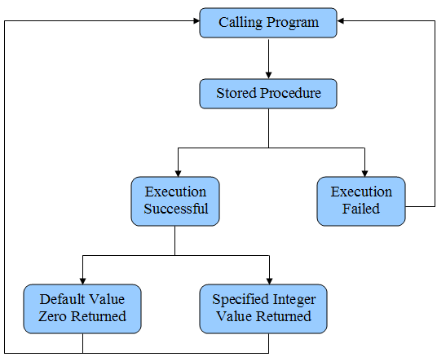
Returning Values

Slide 34
“RETURN” Statement
Example:
CREATE PROCEDURE Cal_Square @num int = 0
AS
BEGIN
RETURN (@num * @num);
END
Executing the stored procedure:
DECLARE @square int;
EXECUTE @square = Cal_Square 10;
PRINT @square;

Slide 35
Input Parameters
Example:
CREATE PROCEDURE StateWise_Customers
@statename varchar(40)
AS
SELECT AccNo, AccName, City, State
FROM Customer_Details
WHERE State= @statename
To execute the stored procedure and pass values as input parameters:
EXECUTE StateWise_Customers ‘California’

Slide 36
Output Parameters
Syntax:
CREATE PROCEDURE <procedure_name>
@parameter <data_type>,
@parameter <data_type> OUTPUT
AS <sql_statement>
To execute:
EXECUTE <procedure_name>< parameters> [OUTPUT]

Slide 37
Nested Stored Procedures
In SQL Server 2005, you can call stored procedures from inside othe stored procedures. This architecture of calling one procedure from another procedure is referred to as nested stored procedure architecture.
The maximum level of nesting supported by SQL Server 2005 is 32. If the level of nesting exceeds 32, the calling process fails.
Example:
  CREATE PROCEDURE NestedProcedure
  AS
  EXECUTE Display_Customers
  EXECUTE CityWise_Customers ‘New York’

Slide 38
Handling Error Messages
SQL Server 2005 introduces the TRY…CATCH construct for handling errors in stored procedures. The TRY…CATCH construct consists of two blocks of code, the TRY block and the CATCH block.
When an error is detected in an SQL statement inside a TRY block, control is passed to the CATCH block, where the error can be processed. After the error is processed in the CATCH block, the control is transferred to the SQL statement that is written after the END CATCH statement. The SQL statements in the TRY block written after the statement that generates the error are not executed.

Slide 39
TRY…CATCH Construct
  BEGIN TRY
    .
    {Error detected}
    .
  END TRY
  BEGIN CATCH
    {Error detected}
  END CATCH
If there are no errors inside the TRY block, control passes to the statement written after the END CATCH statement of the corresponding CATCH block.

Slide 40
“@@ERROR” Function
Error handling in stored procedures can also be assisted by the @@ERROR function. The @@ERROR function returns the error number for the error occurring in the last Transact-SQL statement (returns 0 if no errors).
Example:
INSERT INTO Employee_Details
VALUES (16,’David’,’Johnson’,’1981/12/29’,’M’,’Miami’,’12000’);
IF @@ERROR <> 0
PRINT ‘An error occurred while inserting the record.’;
GO

Slide 41
Module 8 - Summary
The sp_helptext procedure can be used to display the stored procedure definition.
An object that references another object is considered dependent on that object. The sp_depends procedure is used to display the information about database object dependencies.
In a stored procedure, statements or parameters can be changed by either re-creating the stored procedure or by altering an existing stored procedure.
A stored procedure can be dropped if it is not needed anymore.
Stored procedures can be nested; that is, a stored procedure can be called from within another stored procedure.
In stored procedures, error handling is done using the TRY…CATCH construct.

